Slide 1
Getting to Know Apache Kafka’s Architecture

Slide 2




Apache Kafka as a Messaging System
Producers Consumers

Slide 3
Apache Kafka as a Messaging System
Producers Topics Consumers
To: “X” Retrieve: “X”
“X”
“Y”
To: “Y”
Retrieve: “Y”

Slide 4

Apache Kafka as a Messaging System
Producers Consumers
Broker

Slide 5




Apache Kafka as a Messaging System
Producers Broker Consumers
A
~/A/…
B
~/B/…
C
~/C/…

Slide 6
How Apache Kafka Starts to Differentiate
Producers Consumers
LinkedIn: 1,400 brokers => 2 petabytes per week
Broker | Broker
Broker | Broker
“A high-throughput distributed messaging system.”

Slide 7
The Apache Kafka Cluster
Producers
Cluster
Consumers
Broker
Broker
Broker
Broker

Slide 8
The Apache Kafka Cluster
Producers
Cluster Size: 1
Consumers
Broker
Broker
Broker
Broker

Slide 9

The Apache Kafka Cluster
Producers
Cluster Size: 2
Consumers
Broker
Broker
Broker
Broker

Slide 10
The Apache Kafka Cluster
Producers
Cluster Size: 2
Consumers
Broker
Broker
Broker
Broker

Slide 11


The Apache Kafka Cluster
Producers
Cluster Size: 4
Consumers
Broker | Broker
Broker | Broker
Later…

Slide 12

Distributed Systems
Collection of resources that are instructed to achieve a specific goal or function
Consist of multiple workers or nodes
The system of nodes require coordination to ensure consistency and progress towards a common goal
Each node communicates with each other though messages
KAFKA BROKERS

Slide 13






Distributed Systems: Controller Election
Work Items
Attendance
Status

Slide 14



Distributed Systems: The Cluster
KAFKA CLUSTER

Slide 15



Distributed Systems: Getting Work Done
PRODUCER

Slide 16

Worker availability and health
Task redundancy

Slide 17



Distributed Systems: Getting Work Done (Reliably)
“we cannot afford loss… three replicas, please”
LEADER
LEADER
PEER
PEER
PEER
PEER
PEER

Slide 18





Distributed Systems: Getting Work Done (Reliably)
”here you go…”
“we have a quorum”
LEADER
LEADER
“not ready or able”
PEER
PEER
FOLLOWER
FOLLOWER
PEER

Slide 19


Sources of Work in Apache Kafka
PRODUCER
CONSUMER
KAFKA CLUSTER

Slide 20
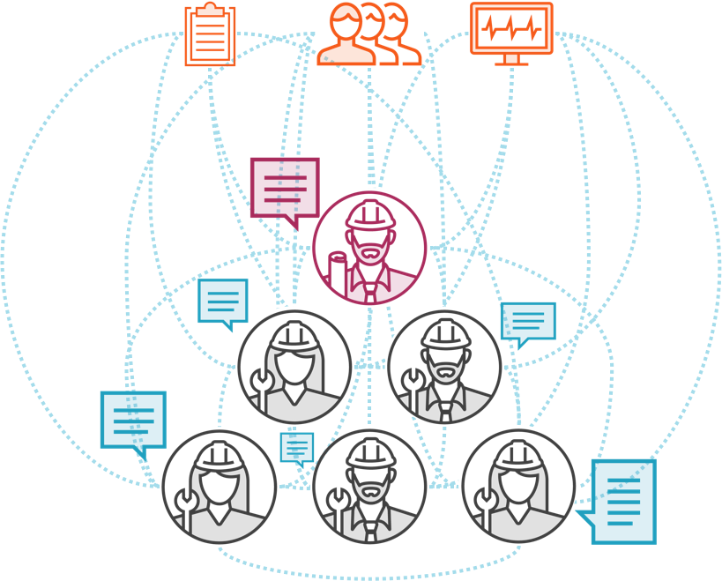
Distributed Systems: Communication and Consensus
Worker node membership and naming
Configuration management Leader election
Health status

Slide 21

Apache Zookeeper
Centralized service for maintaining metadata about a cluster of distributed nodes
Configuration information
Heath status
Group membership
Hadoop, HBase, Mesos, Solr, Redis, and Neo4j
Distributed system consisting of multiple nodes in an “ensemble”

Slide 22
Apache Kafka’s Distributed Architecture
APACHE ZOOKEEPER
PRODUCER
CONSUMER
KAFKA CLUSTER

Slide 23

Apache Kafka is a Pub-Sub messaging system, consisting of:
Summary
Producers and Consumers
Brokers within a Cluster
Characteristics of distributed systems
Worker node roles: Controllers, Leaders, Peers and Followers
Reliability through replication
Consensus-based communication
Role of Apache Zookeeper

